Slide 1

Data Manipulation
Fundamentals
Understanding Variables, Collections, and Arguments
Your Name

Slide 2
Data Manipulation
Fundamentals
Understanding Variables, Collections, and Arguments
Your Name

Slide 3

Variables: Storage and Scope
What are Variables?
• Named containers for holding data.
• Store, manage, and pass information in workﬂows.
• Fundamental building block for dynamic RPA processes.
DATA STORAGE
RPA ESSENTIAL
Common Data Types
Declaring & Initializing
• Text (String)
✓ Deﬁne name and data type.
✓ Assign an initial (default) value.
✓ Allocates memory for the data.
• Number (Int, Double)
• Boolean (True/False)
• DateTime & Arrays
TYPE SAFETY
VALUE SIGNIFICANCE
WORKFLOW BUILD
MEMORY ALLOCATION
Understanding Scope
Best Practices
"Local: Limited to its container (e.g., Sequence)."
"Global: Accessible throughout the entire workﬂow."
• Use descriptive, clear naming conventions.
• Prefer local scope to avoid conﬂicts.
• Initialize variables at declaration.
• Manage variable lifetime eﬃciently.
LOCAL
GLOBAL
DATA FLOW
CODE QUALITY
MAINTAINABILITY
"Best practices for naming variables make them easier to distinguish and manage in complex workﬂows."
Source: UiPath Documentation, roboautomator.com, forum.uipath.com, stackoverﬂow.com

Slide 4
Variables: Storage and Scope
What are Variables?
• Named containers for holding data.
• Store, manage, and pass information in workﬂows.
• Fundamental building block for dynamic RPA processes.
DATA STORAGE
RPA ESSENTIAL
Common Data Types
Declaring & Initializing
• Text (String)
✓ Deﬁne name and data type.
✓ Assign an initial (default) value.
✓ Allocates memory for the data.
• Number (Int, Double)
• Boolean (True/False)
• DateTime & Arrays
TYPE SAFETY
VALUE SIGNIFICANCE
WORKFLOW BUILD
MEMORY ALLOCATION
Understanding Scope
Best Practices
"Local: Limited to its container (e.g., Sequence)."
"Global: Accessible throughout the entire workﬂow."
• Use descriptive, clear naming conventions.
• Prefer local scope to avoid conﬂicts.
• Initialize variables at declaration.
• Manage variable lifetime eﬃciently.
LOCAL
GLOBAL
DATA FLOW
CODE QUALITY
MAINTAINABILITY
"Best practices for naming variables make them easier to distinguish and manage in complex workﬂows."
Source: UiPath Documentation, roboautomator.com, forum.uipath.com, stackoverﬂow.com

Slide 5

Collections: Organizing Data
Lists / Arrays
Why We Need Them
Ordered sequences, mutable (changeable), and accessed by
index.
- Eﬃciently manage multiple values.
Indexed
Dynamic Size
- Handle structured and unstructured
data.
Dictionaries / Maps
- Streamline RPA workﬂow logic.
- Enhance data processing speed.
Key-value pairs for structured data, oﬀering fast retrieval by key.
Associative
Keyed Access
Sets
Unordered collections of unique elements, perfect for
membership tests.
Data Structuring
RPA Eﬃciency
No Duplicates
Membership
Common Operations
Adding elements
Removing elements
Accessing data
Transforming Raw Data into Structured
Intelligence
Iterating through
Checking existence
Unorganized
Data
Collections
Logic
Organized
Insights
Manipulation
Query
Source: UiPath Documentation Portal, Mastering UiPath Studio

Slide 6
Collections: Organizing Data
Lists / Arrays
Why We Need Them
Ordered sequences, mutable (changeable), and accessed by
index.
- Eﬃciently manage multiple values.
Indexed
Dynamic Size
- Handle structured and unstructured
data.
Dictionaries / Maps
- Streamline RPA workﬂow logic.
- Enhance data processing speed.
Key-value pairs for structured data, oﬀering fast retrieval by key.
Associative
Keyed Access
Sets
Unordered collections of unique elements, perfect for
membership tests.
Data Structuring
RPA Eﬃciency
No Duplicates
Membership
Common Operations
Adding elements
Removing elements
Accessing data
Transforming Raw Data into Structured
Intelligence
Iterating through
Checking existence
Unorganized
Data
Collections
Logic
Organized
Insights
Manipulation
Query
Source: UiPath Documentation Portal, Mastering UiPath Studio

Slide 7

Arguments: Purpose and Use in Functions
04
What are Arguments?
Positional Arguments
Data values provided to a function when it is called.
Values are assigned based on their order.
Key Point: Order matters signiﬁcantly.
Example:
Pass data between workﬂows
Enables modular & reusable code
print_info("John", 30)
// "John" is name, 30 is age
Parameters vs. Arguments
Parameters
Keyword Arguments
Placeholders in the function deﬁnition.
def greet_user(name)
Values are assigned by explicitly naming the
parameter.
Arguments
Actual values passed during the function call.
Key
Oﬀers ﬂexibility and improves
readability.
greet_user("Alice")
Point:
Example:
print_info(age=30, name="Jane")
// Order doesn't matter
"Arguments are the lifeblood of function interaction, enabling dynamic and robust
automation."
Source: Mastering UiPath Studio: Variables and Arguments Explained
Source: How do you pass UiPath variables between sequences and...

Slide 8
Arguments: Purpose and Use in Functions
04
What are Arguments?
Positional Arguments
Data values provided to a function when it is called.
Values are assigned based on their order.
Key Point: Order matters signiﬁcantly.
Example:
Pass data between workﬂows
Enables modular & reusable code
print_info("John", 30)
// "John" is name, 30 is age
Parameters vs. Arguments
Parameters
Keyword Arguments
Placeholders in the function deﬁnition.
def greet_user(name)
Values are assigned by explicitly naming the
parameter.
Arguments
Actual values passed during the function call.
Key
Oﬀers ﬂexibility and improves
readability.
greet_user("Alice")
Point:
Example:
print_info(age=30, name="Jane")
// Order doesn't matter
"Arguments are the lifeblood of function interaction, enabling dynamic and robust
automation."
Source: Mastering UiPath Studio: Variables and Arguments Explained
Source: How do you pass UiPath variables between sequences and...

Slide 9

Advanced Argument Concepts
Default Argument
Variable-Length
Arguments
Pass by Value vs.
Values
Reference
Flexibility Enabled
Dynamic Inputs
Data Integrity
Deﬁne default parameters for
functions, simplifying calls and
handling optional inputs eﬃciently.
Use
*args
for positional tuples
Understand if data is passed as a
copy (value) or direct access
(reference), which is crucial for
preventing side eﬀects.
and
**kwargs
for keyword
dictionaries to accept ﬂexible input
counts.
Key Principle in UiPath
Arguments are crucial in UiPath for seamless data ﬂow and modular workﬂow design, enhancing automation robustness.
Source: Mastering UiPath Studio: Variables and Arguments Explained, Studio - Using Arguments

Slide 10
Advanced Argument Concepts
Default Argument
Variable-Length
Arguments
Pass by Value vs.
Values
Reference
Flexibility Enabled
Dynamic Inputs
Data Integrity
Deﬁne default parameters for
functions, simplifying calls and
handling optional inputs eﬃciently.
Use
*args
for positional tuples
Understand if data is passed as a
copy (value) or direct access
(reference), which is crucial for
preventing side eﬀects.
and
**kwargs
for keyword
dictionaries to accept ﬂexible input
counts.
Key Principle in UiPath
Arguments are crucial in UiPath for seamless data ﬂow and modular workﬂow design, enhancing automation robustness.
Source: Mastering UiPath Studio: Variables and Arguments Explained, Studio - Using Arguments

Slide 11
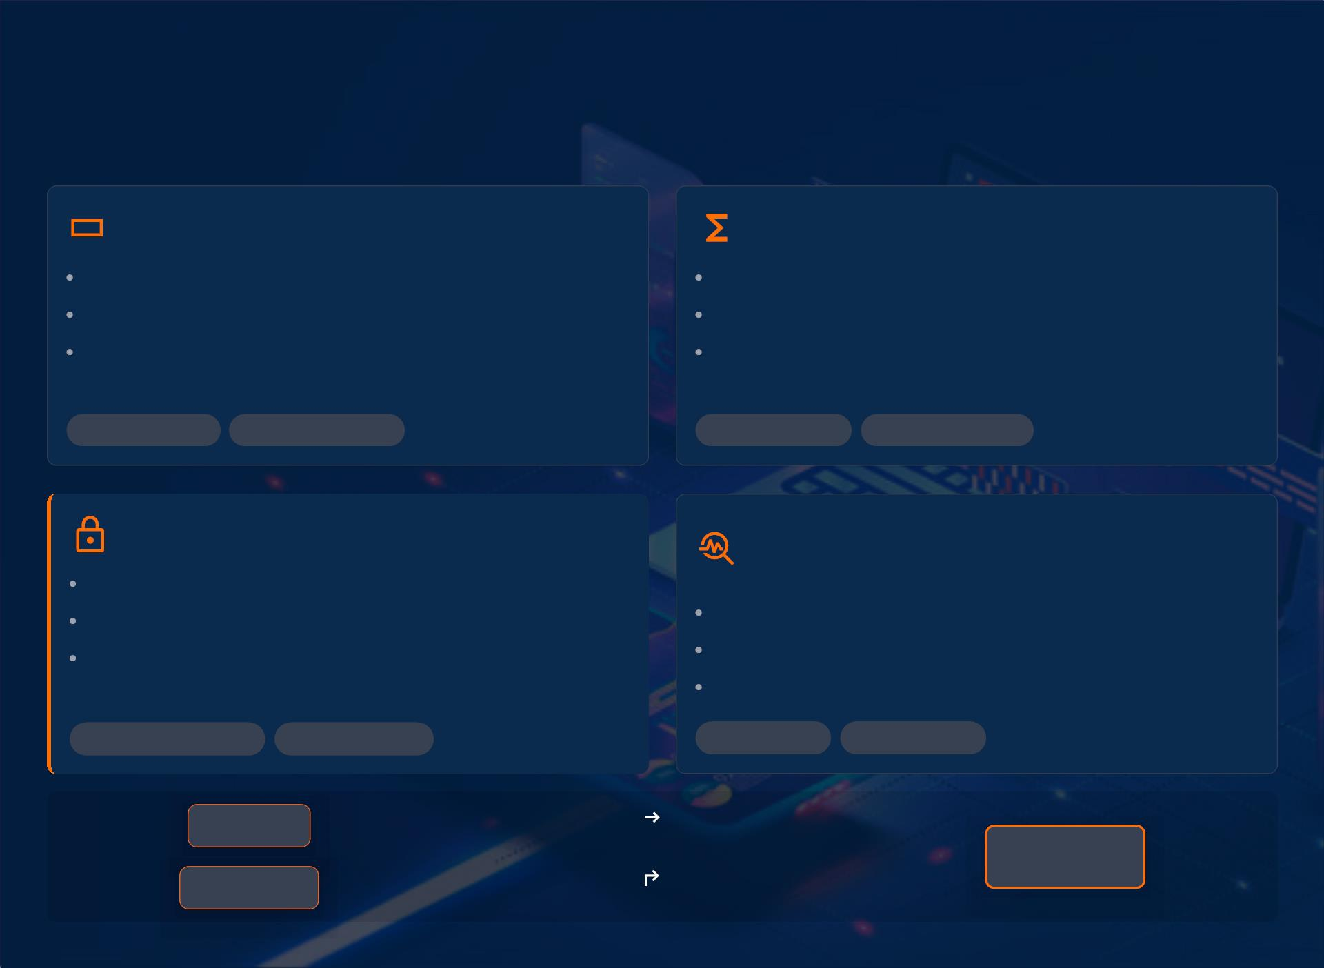
Putting It All Together: Practical
Examples
Variables & Collections
Functions with Arguments
Store data within workﬂows.
Pass data between workﬂows.
Enable reusability of logic.
Deﬁne Input/Output values.
Manage diverse data types.
Use Collections like Lists & Dictionaries.
• Data Storage
• Workﬂow Scope
• Data Transfer
• Modular Design
Manipulating Data Scopes
Troubleshooting & Best
Practices
Control data visibility & lifetime.
Prevent unintended access/modiﬁcation.
Optimize memory and resource use.
Validate data types to avoid errors.
Implement robust error handling.
Adhere to strict naming conventions.
• Contextual Access
• Data Isolation
• Debugging
• Code Clarity
Variables
Passed as Input
Arguments
Collections
Return as Output

Slide 12
Putting It All Together: Practical
Examples
Variables & Collections
Functions with Arguments
Store data within workﬂows.
Pass data between workﬂows.
Enable reusability of logic.
Deﬁne Input/Output values.
Manage diverse data types.
Use Collections like Lists & Dictionaries.
• Data Storage
• Workﬂow Scope
• Data Transfer
• Modular Design
Manipulating Data Scopes
Troubleshooting & Best
Practices
Control data visibility & lifetime.
Prevent unintended access/modiﬁcation.
Optimize memory and resource use.
Validate data types to avoid errors.
Implement robust error handling.
Adhere to strict naming conventions.
• Contextual Access
• Data Isolation
• Debugging
• Code Clarity
Variables
Passed as Input
Arguments
Collections
Return as Output

Slide 13

Key Takeaways and Best Practices
Fundamental Concepts
Best Practices
Variables: Store diverse data.
Clear Naming & Scope
Essential for managing data; includes types like
arrays, numbers, and strings.
Adopt consistent naming conventions for
improved readability and maintainability.
Collections: Organize multiple items.
Optimal Collection Choice
Select the most suitable collection type for
eﬃcient data processing.
Utilize Lists, Dictionaries, and Data Tables for
structured data manipulation.
Arguments: Pass data between workﬂows.
Critical for modular design, enabling data transfer
and reusability across processes.
Eﬀective Argument Handling
Design functions with robust argument
handling for ﬂexibility and reuse.
Beyond the Basics
Connect with Us
Embrace lifelong learning in RPA development.
Email: x@y.com
Dive deeper into advanced data manipulation techniques.
Actively engage with UiPath documentation and community resources.
A clear understanding of data handling components is foundational for robust RPA solutions.

Slide 14
Key Takeaways and Best Practices
Fundamental Concepts
Best Practices
Variables: Store diverse data.
Clear Naming & Scope
Essential for managing data; includes types like
arrays, numbers, and strings.
Adopt consistent naming conventions for
improved readability and maintainability.
Collections: Organize multiple items.
Optimal Collection Choice
Select the most suitable collection type for
eﬃcient data processing.
Utilize Lists, Dictionaries, and Data Tables for
structured data manipulation.
Arguments: Pass data between workﬂows.
Critical for modular design, enabling data transfer
and reusability across processes.
Eﬀective Argument Handling
Design functions with robust argument
handling for ﬂexibility and reuse.
Beyond the Basics
Connect with Us
Embrace lifelong learning in RPA development.
Email: x@y.com
Dive deeper into advanced data manipulation techniques.
Actively engage with UiPath documentation and community resources.
A clear understanding of data handling components is foundational for robust RPA solutions.

